Slide 1
Route Data Processing Steps
By S. Brennan and L. Gao
Last Updated: 2021_10_15

Slide 2
The goal of this presentation is to document and explain the data processing steps used for a typical mapping of a route.
Add Google Earth pics of Wahba and test track routes

Slide 3

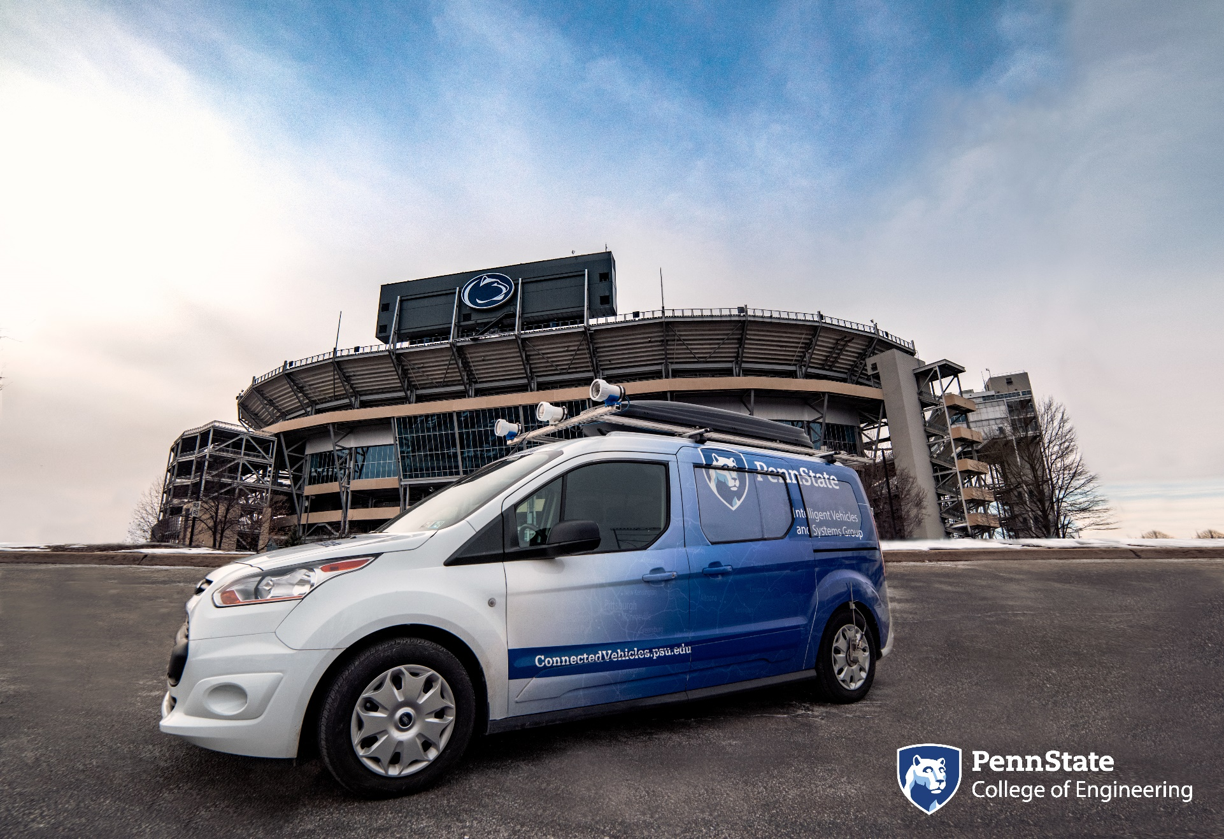
This pertains to the Penn State Mapping van

Slide 4
The mapping van has the following sensors
Details can be found at: www.connectedvehicles.psu.edu

Slide 5
The overview of the steps follow grouping of data into increasingly processed forms
Crude data by indices By time Aligned Merged

Slide 6
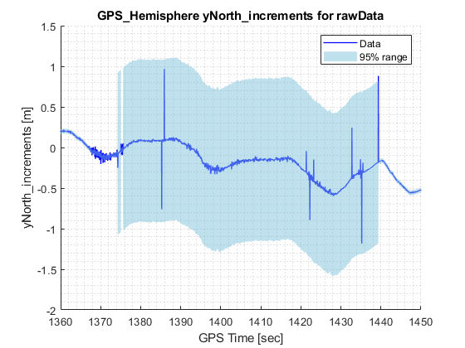
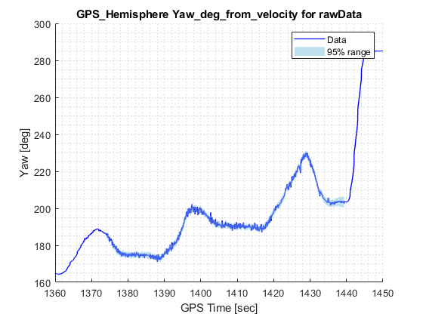
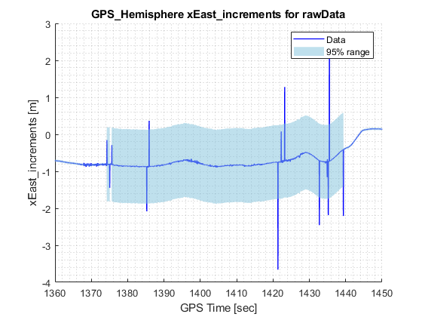
First, we load all data into structure with fields grouped by sensor. This is the rawData structure.
We do this because all data for each sensor individually tends to share the same error behaviors. For example, data from the Hemisphere GPS all tend to drop at the same time, if DGPS goes out.

Slide 7
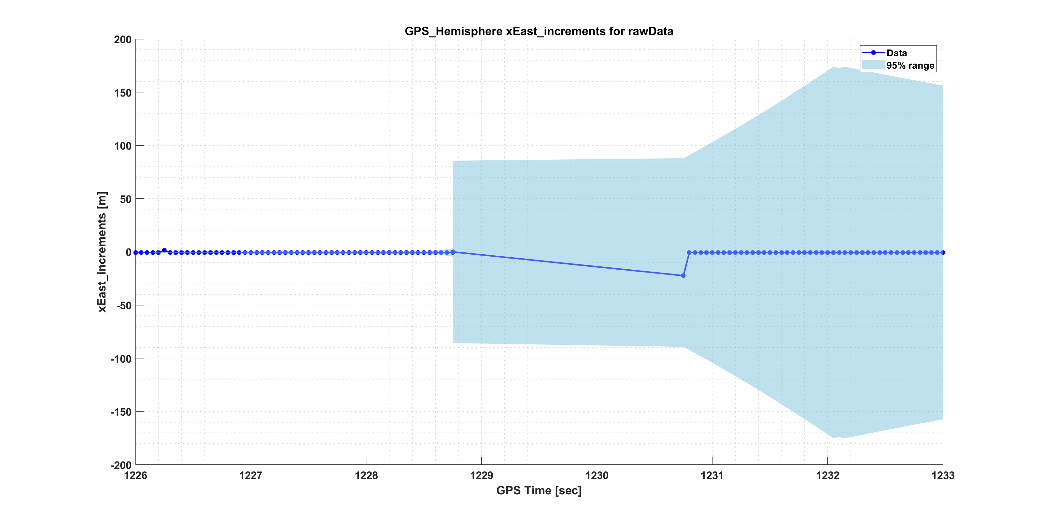
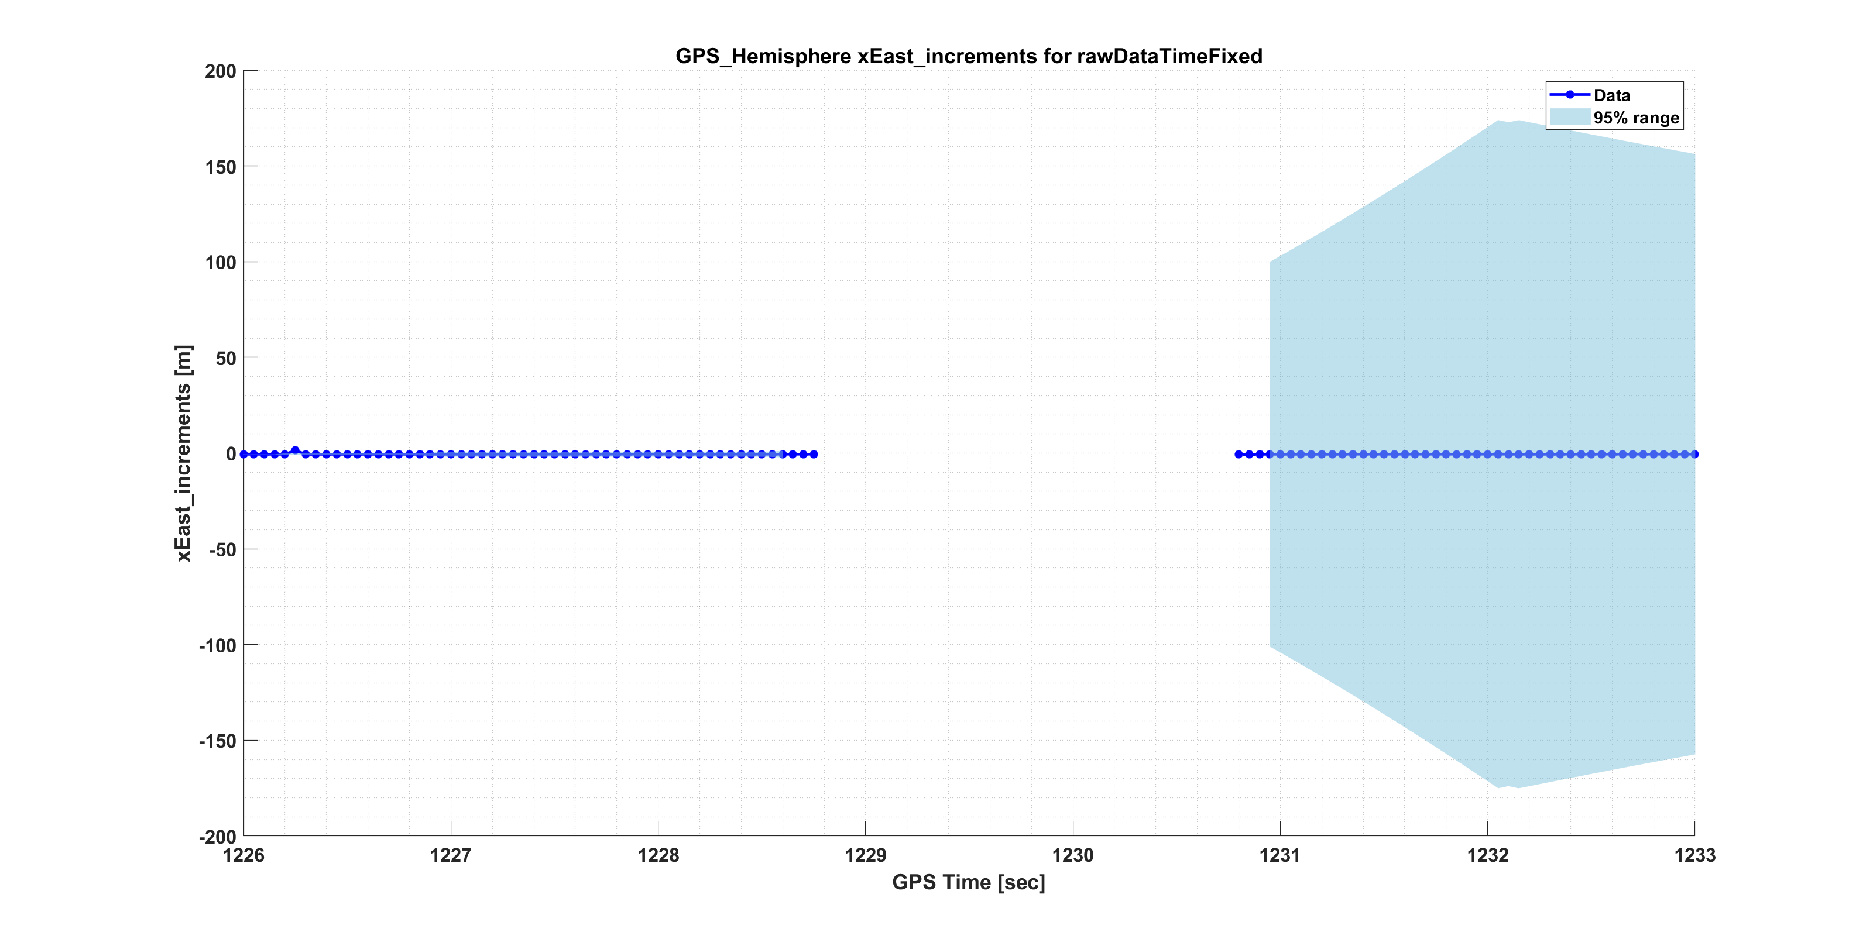
Right after the raw data is loaded, we check if the time is incrementing uniformly in fcn_removeTimeGapsFromRawData. If it does not, the data around this is set to NaN. In later steps, this is interpolated.

Slide 8
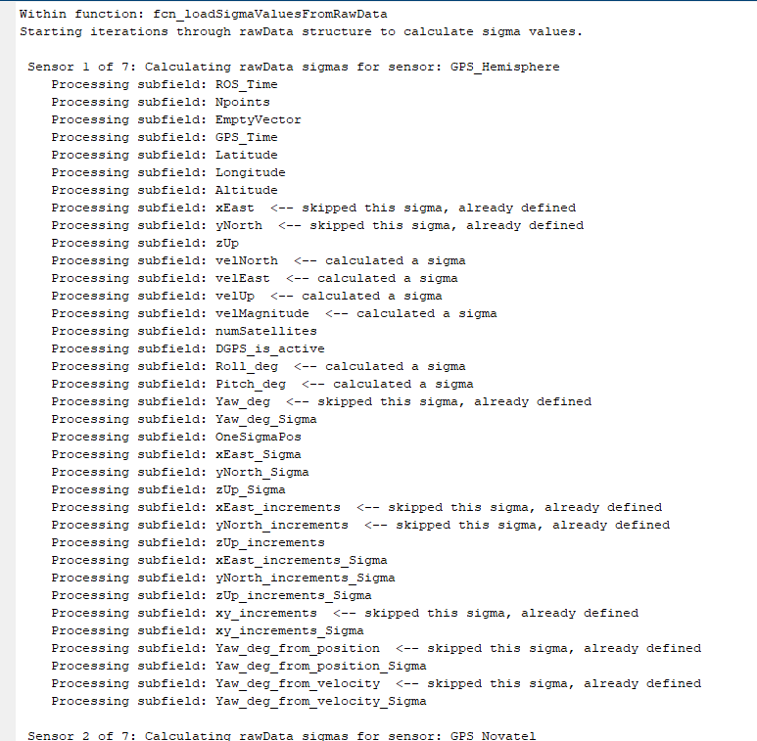
Next: assign to each data a measured or calculated variance. This is the rawDataWithSigmas structure, via function: fcn_loadSigmaValuesFromRawData
If data has Sigmas assigned within raw data, these should be filled in and are skipped here.
If not, they are filled in here.

Slide 9
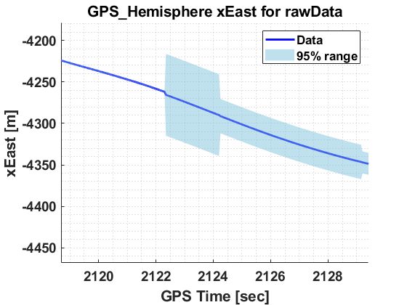
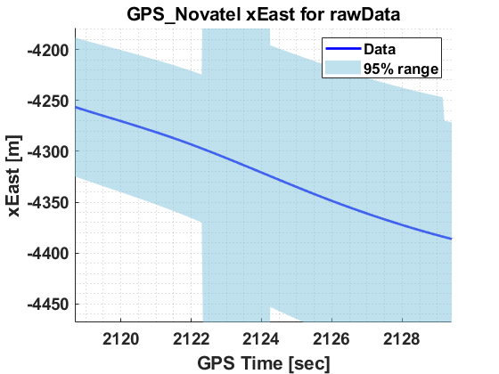
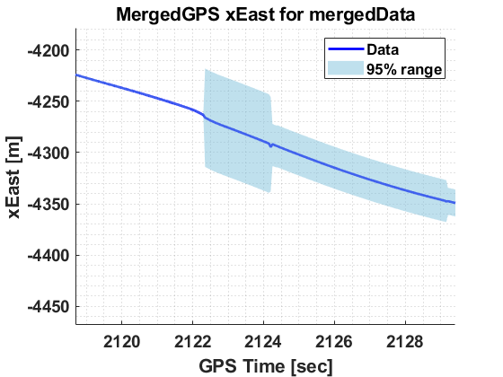
One thing to be careful about when adding variance is that the change in variance must be smooth, like the data. Otherwise, the weighted average can produce jumps, even when the data itself does not have a jump discontinuity. Here’s an example of this causing about a 1 meter jump (before this bug was fixed).

Slide 10
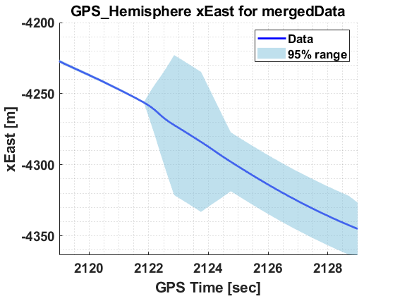
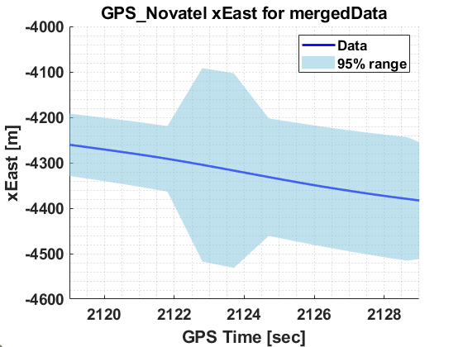
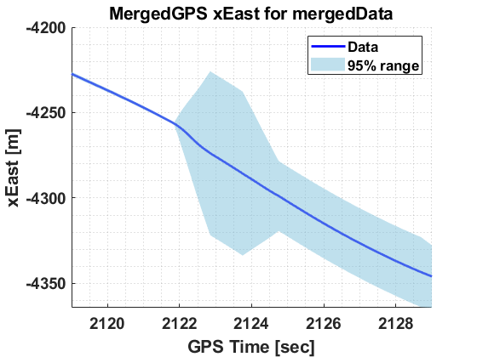
Here’s that same location, after fixing the variance to not be discontinuous.

Slide 11
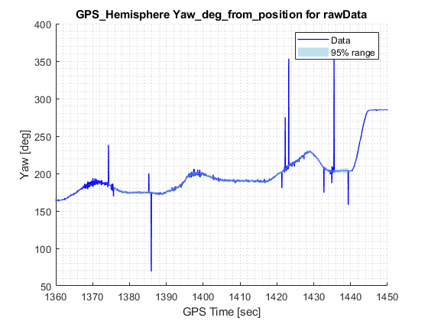
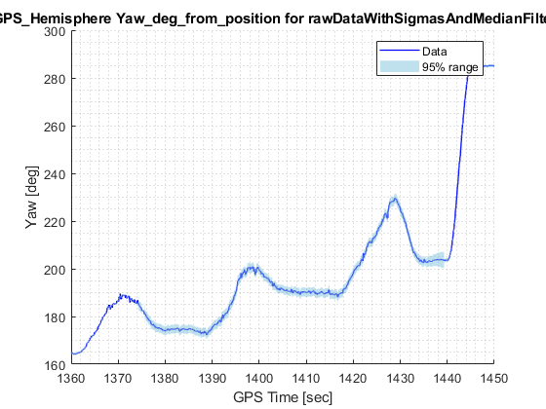
Step 3: Remove outliers via Median filtering. This is the rawDataWithSigmasAndMedianFiltered data structure

Slide 12
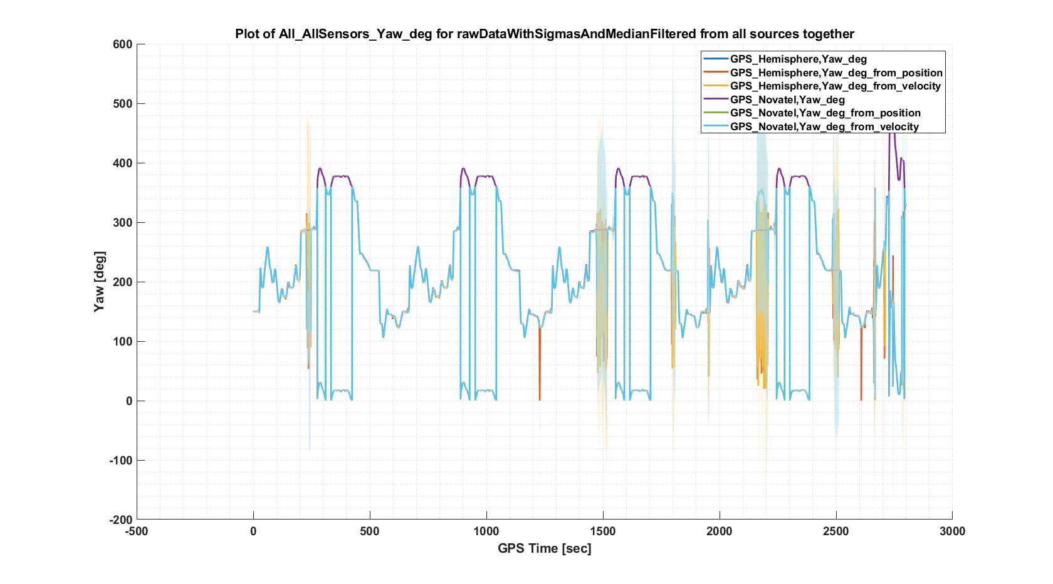
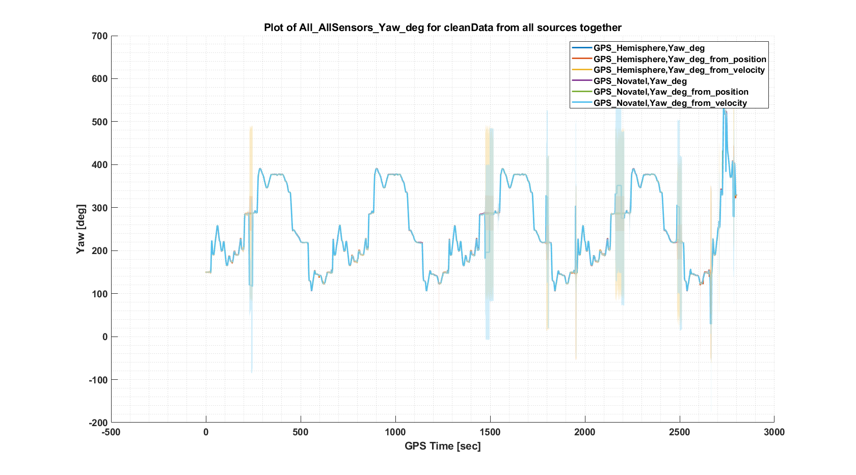
Step 4: Remove additional data artifacts such as yaw angle wrapping. This is the cleanData structure. This has to be done before filtering to avoid smoothing these artificial discontinuities.

Slide 13
Step 4a: Much of the cleaning process is focused on yaw angle. For fcn_cleanGPSData, the Step 4a is to unwrap the yaw angle, i.e. keep it from jumping from 0 to 359 degrees.
%%
function unwrapped_angle = fcn_unwrapAngles(wrapped)
initial_angle = wrapped(1,1); % Grab the first angle
change_in_angle = [0; diff(wrapped)]; % Use diff to find jumps
index_jumps = find(change_in_angle>180); % Tag jumps greater than 180
change_in_angle(index_jumps) = change_in_angle(index_jumps)-360; % Shift these down
index_jumps = find(change_in_angle<-180); % Tag jumps less than -180
change_in_angle(index_jumps) = change_in_angle(index_jumps)+360; % Shift these up
unwrapped_angle = cumsum(change_in_angle) + initial_angle; % Re-add jumps
% After above process, data may be shifted up or down by multiples of 360,
% so shift all data back so mean is between zero and 360
mean_angle = mean(unwrapped_angle);
good_mean = mod(mean_angle,360);
shift = mean_angle - good_mean;
unwrapped_angle = unwrapped_angle - shift;

Slide 14
Step 4b: The next part of the cleaning process addresses zeros that appear in the yaw data, particularly from Hemisphere GPS.

Slide 15
Step 4b: The next part of the cleaning process addresses zeros that appear in the yaw data, particularly from Hemisphere GPS.

Slide 16
This is done by searching within a tolerance and replacing by the nearest neighbor.
% STEP 2: Remove solid zeros
good_indices = find(abs(unwrapped_yaw)>0.000000001); % Set a very low tolerance...
dezeroed_yaw = fcn_replaceBadIndicesWithNearestGood(unwrapped_yaw,good_indices);
function new_data = fcn_replaceBadIndicesWithNearestGood(data,good_indices)
new_data = data; % Pre-fill new data
all_indices = (1:length(data))'; % Grab all indices
moved_enough = ismember(all_indices,good_indices); % Tag bad ones
for i = 1:length(moved_enough) % Loop through indices
if 0==moved_enough(i) % Check if bad one
% Find closest index to stationary one that can work
distances = (i-good_indices).^2;
[~,index] = min(distances);
best_index = good_indices(index);
new_data(i,1) = data(best_index,1);
end
end
end

Slide 17
Step 4c: There are many locations where the yaw is noisy due to non-movement. The kinematics of the vehicle are used to impose constraints that prevent apparent motion when the vehicle is not moving.

Slide 18
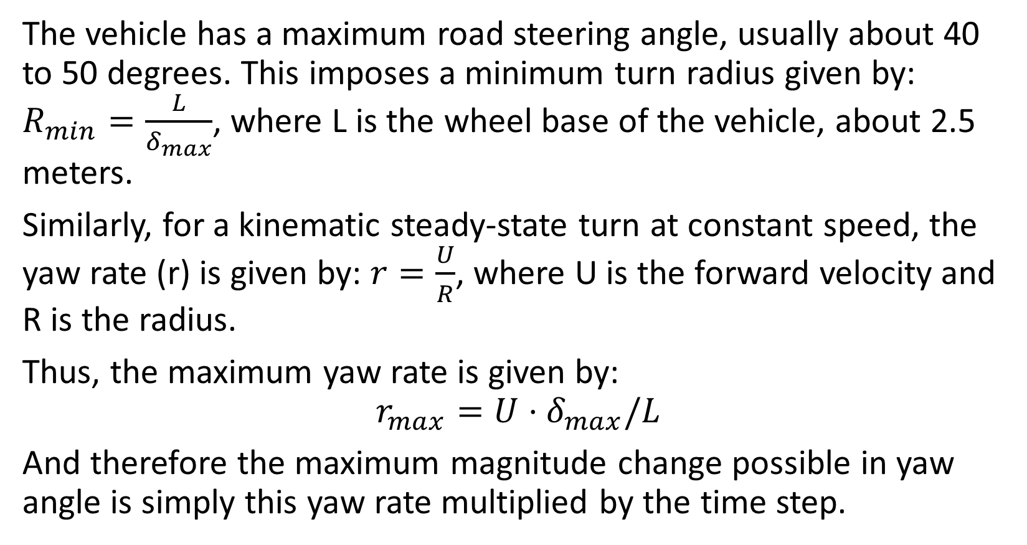
Kinematic filtering ensures that the kinematics of the vehicle are used to impose constraints.
The vehicle has a maximum road steering angle, usually about 40 to 50 degrees. This imposes a minimum turn radius given by: $R_{min}=\frac{L}{δ_{max}}$, where L is the wheel base of the vehicle, about 2.5 meters.
Similarly, for a kinematic steady-state turn at constant speed, the yaw rate (r) is given by: $r=\frac{U}{R}$, where U is the forward velocity and R is the radius.
Thus, the maximum yaw rate is given by:
$$r_{max}=U⋅δ_{max}/L$$
And therefore the maximum magnitude change possible in yaw angle is simply this yaw rate multiplied by the time step.

Slide 19
A threshold of 2 mph is needed to prevent “ghost” speed measurements. This gives the following results.
function kinematic_yaw = fcn_enforceKinematicYawLimits(yaw,t, U,U_limit)
U(U<U_limit) = 0; % Set the slow speeds to zero - can't trust GPS slower than this
L = 2.5; % Typical wheelbase in meters
maxsteer = 40*pi/180; % Maximum steering angle magnitude is about 40 degrees
maxyawrate = U * maxsteer/L; % The kinematics limit
kinematic_yaw = yaw; % Initialize the variable
for i_time = 2:length(kinematic_yaw) % Loop through variables
delta_t = t(i_time) - t(i_time-1); % Calculate delta t
yaw_max = kinematic_yaw(i_time-1,1) + maxyawrate(i_time,1)*delta_t*180/pi;
yaw_min = kinematic_yaw(i_time-1,1) - maxyawrate(i_time,1)*delta_t*180/pi;
if kinematic_yaw(i_time,1) > yaw_max
kinematic_yaw(i_time,1) = yaw_max;
elseif kinematic_yaw(i_time,1) < yaw_min
kinematic_yaw(i_time,1) = yaw_min;
end
end
end

Slide 20

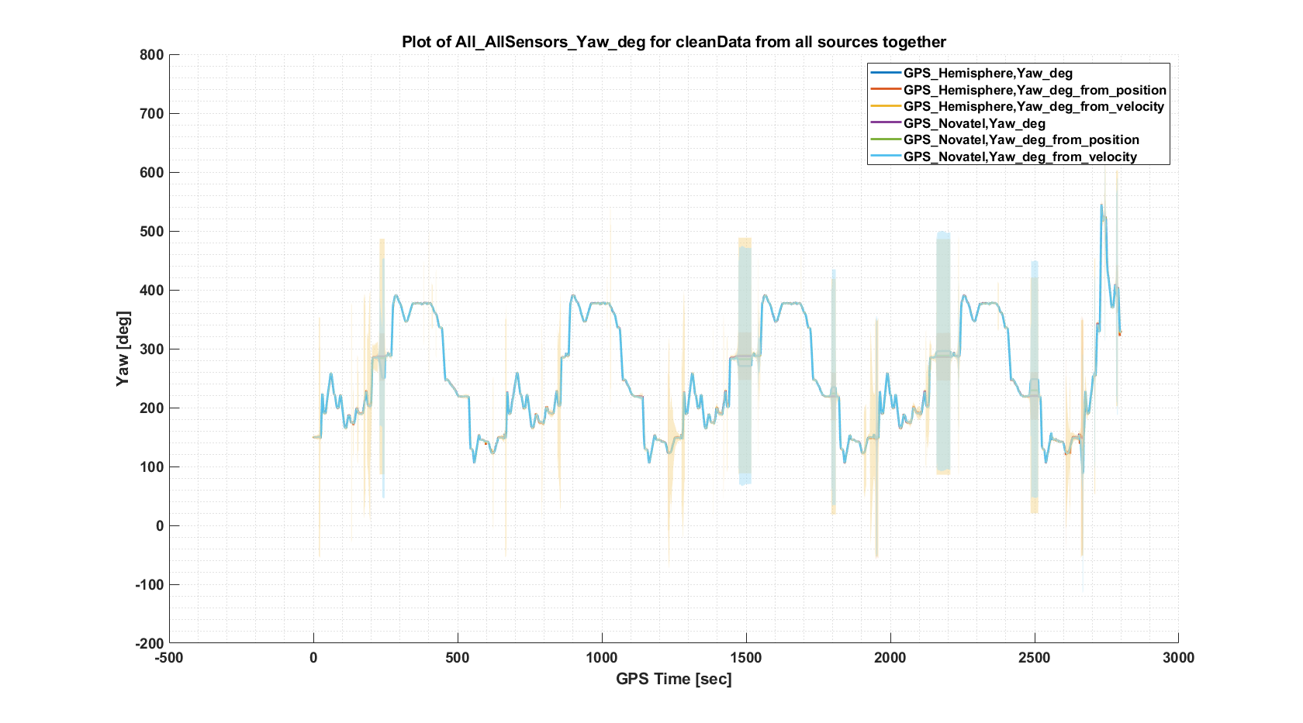
Here are the overall results for yaw angle

Slide 21
Step 5: Time align the data to GPS time (not ROS time). This is the cleanAndTimeAlignedData structure.
This step aligns all the time vectors to GPS time, and ensures that the data has an even time sampling.

Slide 22
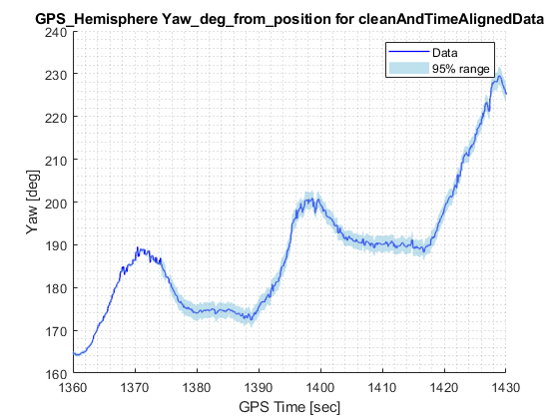
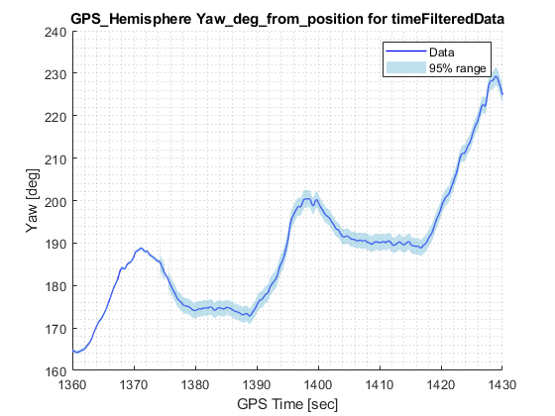
Step 6: Time filter the data. This is the timeFilterData structure.
This part is difficult, because the eigenvalues of the vehicle model change with speed (become slower). For now, a constant 2nd-order filter is used, with cutoff frequency of 1 Hz.

Slide 23
Ultimately, we should use the eigenvalues of the closed-loop dynamics, which can be calculated from the bicycle model
This turns out to be the same as the denominator of the transfer function from input to any measured output.

Slide 24
Step 7: Merge each signal by those that are common along the same state. This is in the structure mergedData

Slide 25
Step 8: Merge the data via Kalman Filtering. Step 1 is to merge Yaw and YawRate, and Velocity - generally. This is in the structure mergedByKFData
A bug:
TripName:Altoona to State College MappingVan 2021-01-23. Start_time:2021-01-23 15:02:34.0. End_time:2021-01-23 15:45:41.0

Slide 26
Step 9: Perform kinematic filtering, e.g. ensuring consistency between Yaw and integrated YawRate,

Slide 27
Step 10: Calculate predicted increments in xEast and yNorth based on measurements and yaw/velocity calculations, merging with Bayesian averages.

Slide 28
Step 11: Automatically generate report of data processing results.

Slide 29
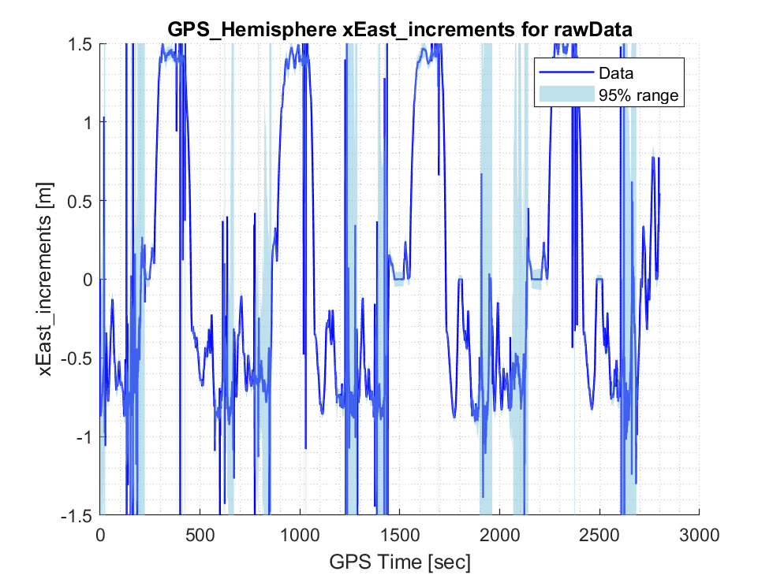
Here’s an illustration of the effects of results on x increments
Raw Data

Slide 30
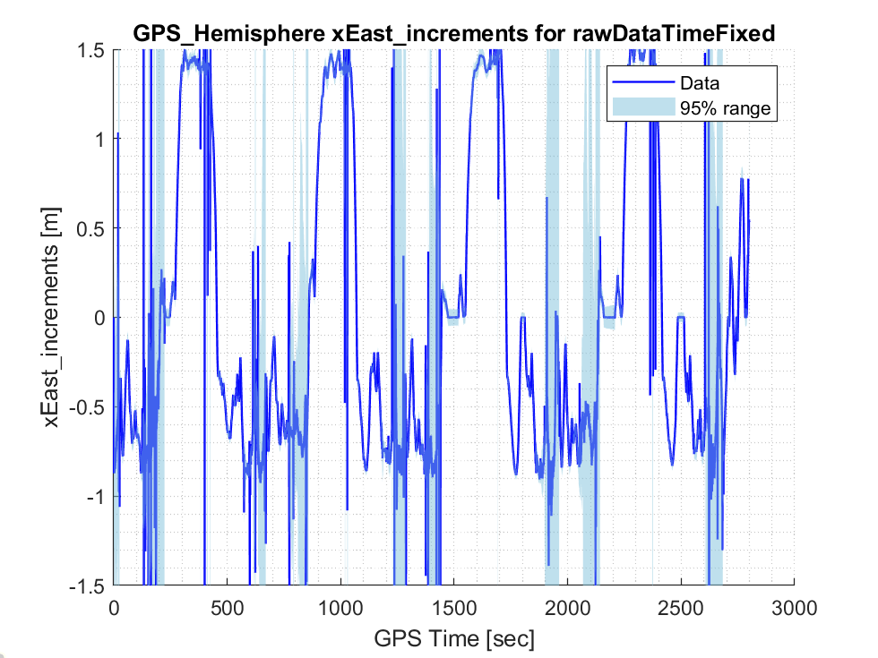
Here’s an illustration of the effects of results on x increments
Raw Data after Time Fixed

Slide 31

Here’s an illustration of the effects of results on x increments
Raw Data after Time Fixed and Sigma values added

Slide 32
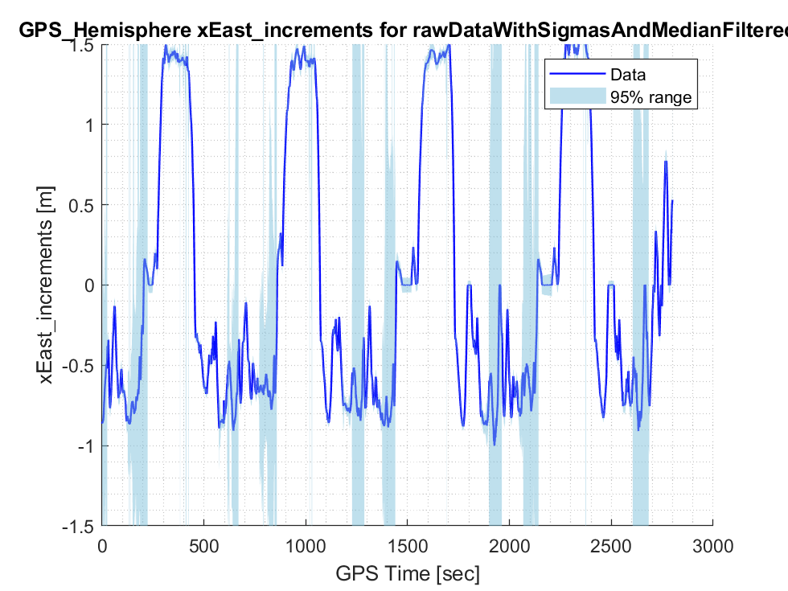
Here’s an illustration of the effects of results on x increments
Raw Data after Time Fixed and Sigma values added

Slide 33
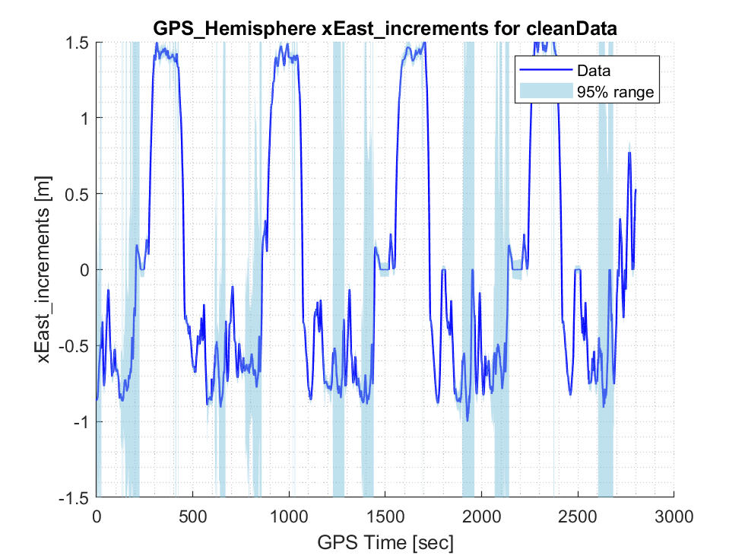
Here’s an illustration of the effects of results on x increments
Raw Data after Cleaned and Filtered

Slide 34
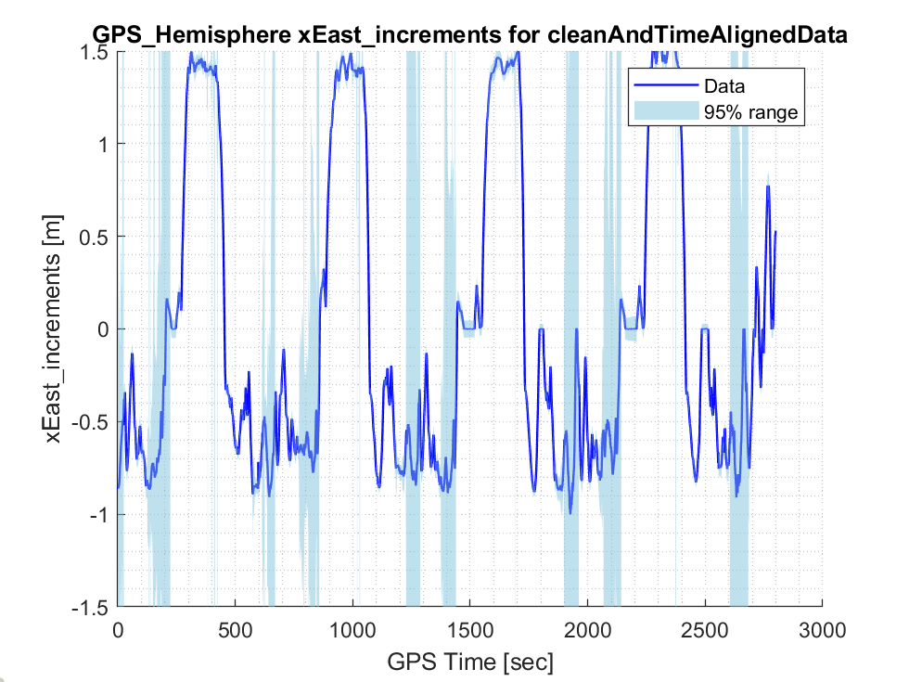
Here’s an illustration of the effects of results on x increments
Cleaned and Time Aligned

Slide 35
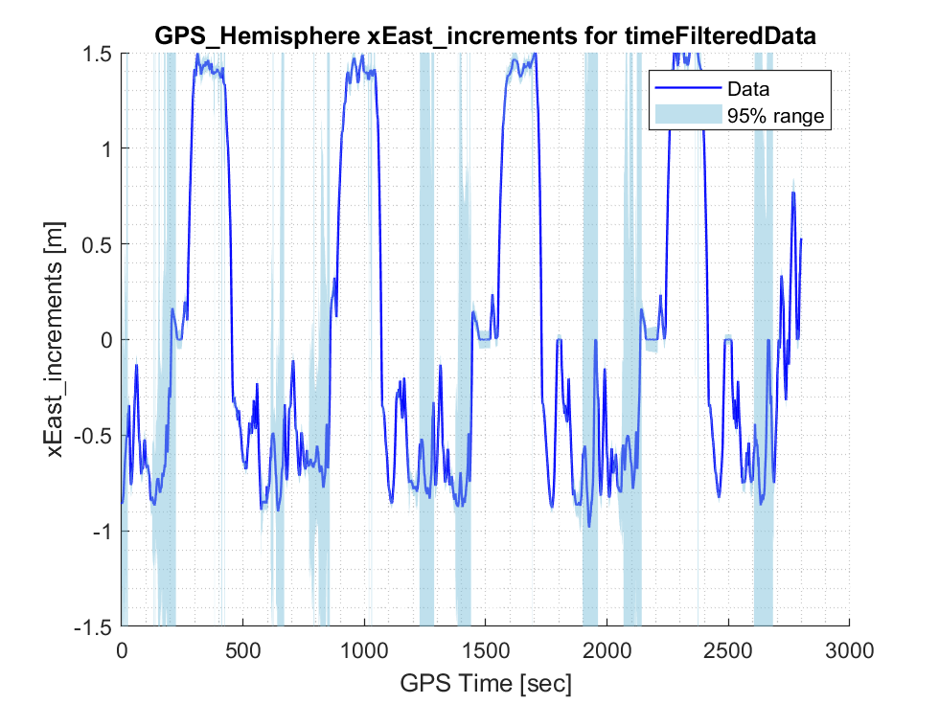
Here’s an illustration of the effects of results on x increments
After time filtering

Slide 36
Here’s an illustration of the effects of results on position plots (XY)
Raw Data

Slide 37
Here’s an illustration of the effects of results on position plots (XY)
Outliers removed

Slide 38
Here’s an illustration of the effects of results on position plots (XY)
Outliers removed

Slide 40
The Kalman Filtering cannot remove jump discontinuities, as these are not zero mean guassian processes
Instead, we use template matching within state-space plots.

Slide 41
Template matching is motivated by the data in state-space exhibiting odd jumps (this is Hemisphere xEast, rawData)

Slide 42
It’s especially hard to filter because it curves back onto itself in some locations, yet filtering it in time domain decouples the states.

Slide 43
To find jumps, we look at the cumulative sum of error between the predicted and actual increments, e.g. the per-station bias in the signal. Jump discontinuities are found by a threshold based on standard deviation.
Biases showing discovery of jumps Their location in state-space

Slide 44
Here’s a close-up of the jumps discovered via this process

Slide 45
At the start and end of the trajectory, we ensure that there is DGPS data. We can compare the skew of the predicted fit at start and end to estimate the skew in locations without DGPS.

Slide 46
With the data aligned, we can return the corrected prediction (using smooth predictions) or corrected increments (noisy but cleaned versions of the original increments)

Slide 47
Here’s some example results from key areas: (ydata from Hemisphere, 1st pair set)

Slide 48
Here’s some example results from key areas: (ydata from Hemisphere, 2nd pair set)

Slide 49
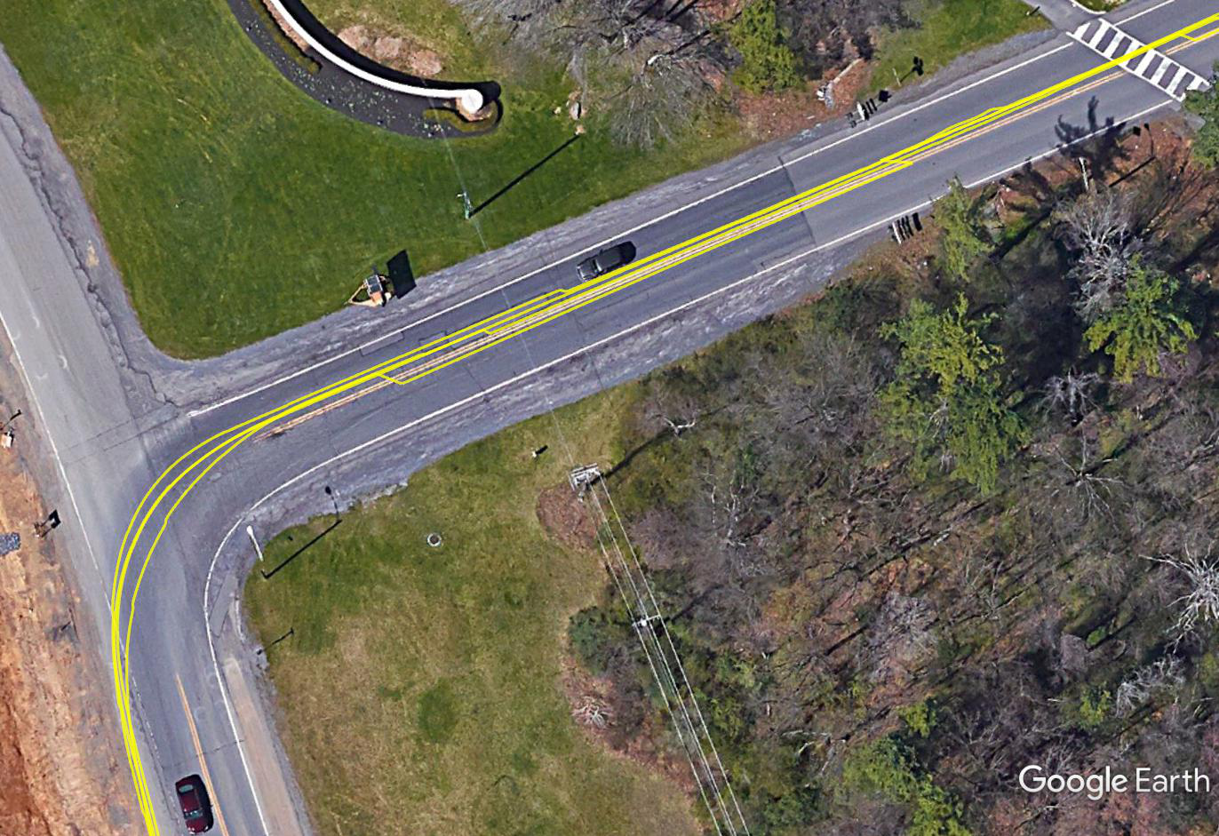
Here’s a comparison of the resulting XY plots in Google Earth (via the KML file)
Raw data at Toftrees turn toward I-99, showing merged with No Jumps

Slide 50
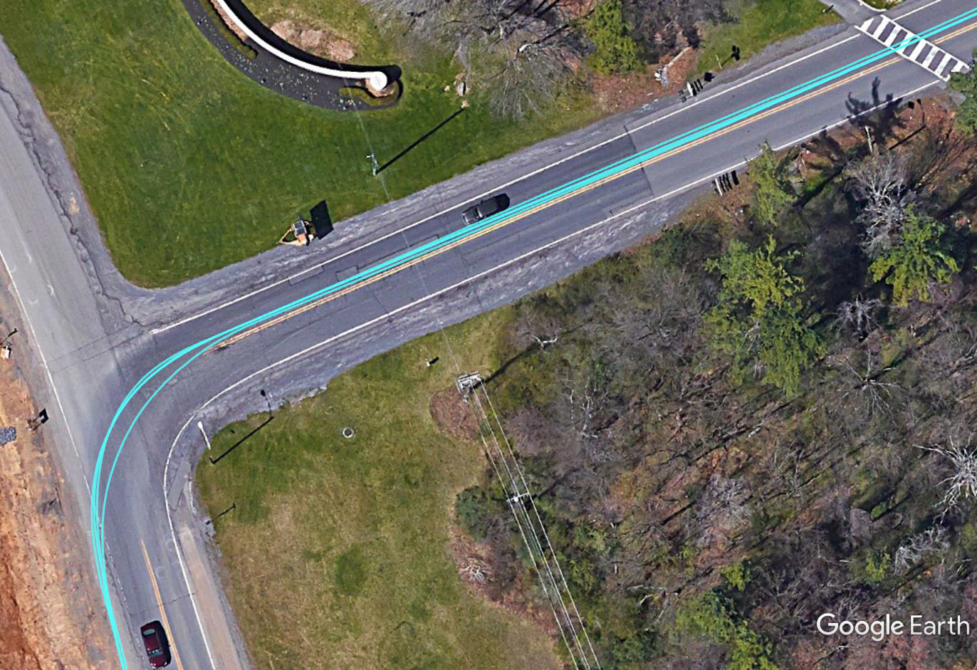
Here’s a comparison of the resulting XY plots in Google Earth (via the KML file)
Raw data at Toftrees turn toward I-99, showing merged with No Jumps

Slide 51
Station calculations: Station step 1: Define start and end of segments

Slide 52
Station step 2: Using start/end, automatically break data into laps (and/or routes)

Slide 53
Station step 3: Determine the s-coordinate average along each lap, removing outliers

Slide 54
Station step 4: Decimate data to the same s-coordinate

Slide 55
Many of the work we have done in this repo can be replaced by the MATLAB built-in Signal Processing functions
Check the Timetables data type for time-sampled data and corresponding functions.
It looks that Synchronize and fillmissing functions are useful.
Check Signal Processing Onramp course to learn methods for spectral analysis.

